Slide 1

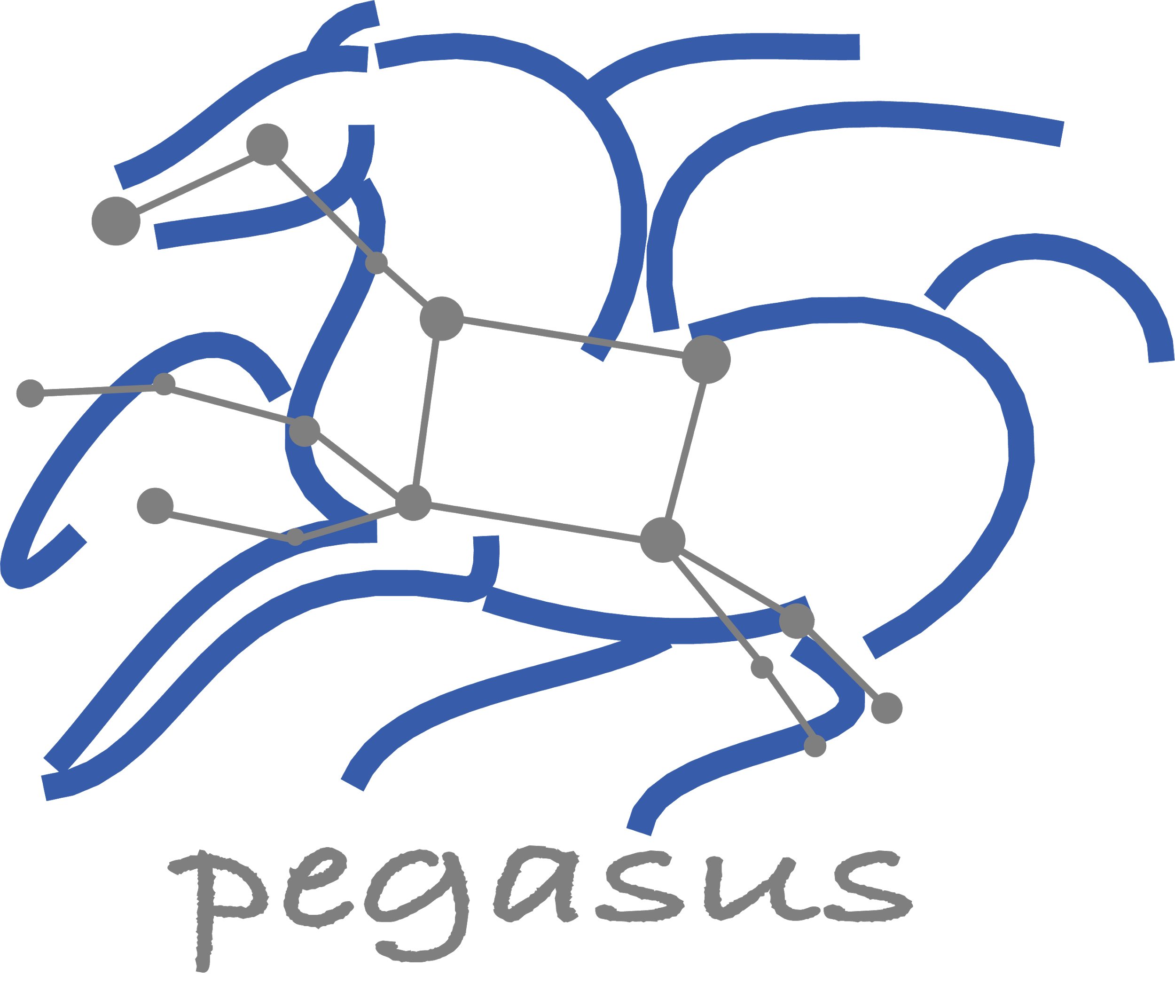




Pegasus 5.0 Workflows
Karan Vahi Information Sciences Institute
University of Southern California, School of Engineering
vahi@isi.edu

Slide 2
What are Scientific Workflows
Conducts a series of computational tasks.
Workflow Building Blocks
Resources distributed across Internet.
Chaining (outputs become inputs) replaces manual hand-offs.
Is
Is
Is
Is
Accelerated creation of products.
Is
bin_0.txt
bin_1.txt
bin_2.txt
bin_3.txt
Ease of use - gives non-developers access to sophisticated codes.
listing.txt
Resources distributed across Internet.
Cat
Provides framework to host or assemble community set of applications.
pegasus.txt
binaries.txt
Honors original codes. Allows for heterogeneous coding styles.
Framework to define common formats or standards when useful.
split
curl
Promotes exchange of data, products, codes. Community metadata.
part.a
part.b
part.c
part.d
Pegasus.html
Multi-disciplinary workflows can promote even broader collaborations.
WC
WC
WC
WC
E.g., ground motions fed into simulation of building shaking.
split
Certain rules or guidelines make it easier to add a code into a workflow.
count.txt.a
count.txt.b
count.txt.c
count.txt.d
count.txt
Slide Content Courtesy of David Okaya, SCEC, USC

Slide 3


Why Pegasus?
Automates Complex, Multi-stage Processing Pipelines
Automate
Enables Parallel, Distributed Computations
Automatically Executes Data Transfers
Recover
Reusable, Aids Reproducibility
Records How Data was Produced (Provenance)
Handles Failures with to Provide Reliability
Debug
Keeps Track of Data and Files
Ensures Data Integrity during workflow execution
NSF funded project since 2001,
with close collaboration with HTCondor team

Slide 4
Workflow Challenges Across Domains
Our Focus
Describe complex workflows in a simple way
Access distributed, heterogeneous data and resources (heterogeneous interfaces)
Deal with resources/software that change over time
Ease of use. Ability to debug and monitor large workflows
Separation between workflow description and workflow execution
Workflow planning and scheduling (scalability, performance)
Task execution (monitoring, fault tolerance, debugging, web dashboard)
Provide additional assurances that a scientific workflow is not accidentally or maliciously tampered with during its execution.

Slide 5

Some of The Success Stories...

Slide 6
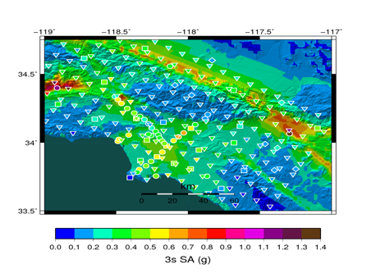
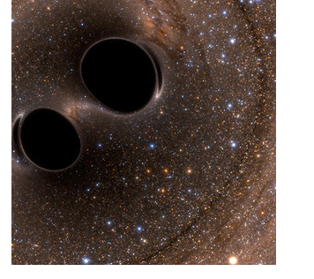
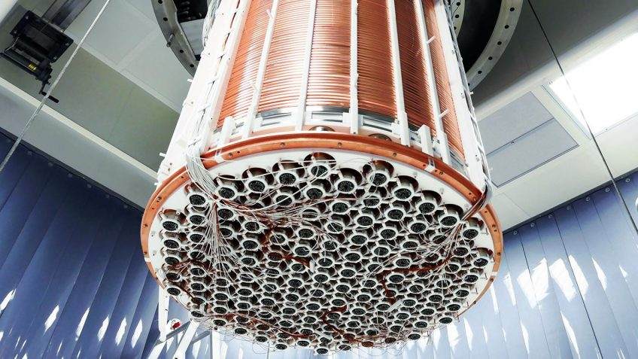
XENONnT - Dark Matter Search
Southern California Earthquake Center’s CyberShake
Mix of MPI and single-core jobs, mix of CPU, GPU codes. Large data sets (10s of TBs), ~300 workflows with 420,000 tasks each
Supported since 2005: changing CI, x-platform execution
First Physics-Based “Shake map” of Southern California
Laser Interferometer Gravitational-Wave Observatory (LIGO)
High-throughput computing workload, access to HPC resources, ~ 21K Pegasus workflows, ~ 107M tasks
Supported since 2001, distributed data, opportunistic computing resources
First direct detection of a gravitational wave (colliding black holes)
Custom data management
Rucio for data management
MongoDB instance to track science runs and data products.
Monte Carlo simulations and the main processing pipeline.

Slide 7
Southern California Earthquake Center’s CyberShake
Builders ask seismologists:
What will the peak ground motion be at my new building in the next 50 years?
Seismologists answer this question
using Probabilistic Seismic Hazard Analysis (PSHA)
SCEC/USC
Titan, Blue Waters
CPU jobs
(Mesh generation, seismogram synthesis)
Serial,
1 core x 0.1 hr
Pre-processing
1,094,000 node-hours
Configuration
Files
(2 GB)
GPU jobs:
Mesh Generation
Parallel,
3840 cores x 0.4 hr
439,000 node-hours
AWP-ODC finite-difference code
5 billion points per volume, 23,000 timesteps
200 GPUs for 1 hour
Velocity
Mesh
(120 GB)
SGT X
Simulation
SGT Y
Simulation
Parallel,
800 GPUs x 1hr
Data Product
Generation
Blue Waters
Strain Green Tensors (1.5 TB)
Titan:
421,000 CPU node-hours, 110,000 GPU node-hours
Post-processing
Parallel,
3712 cores x 11 hr
Blue Waters:
Seismograms & intensity measures (8TB)
673,000 CPU node-hours, 329,000 GPU node-hours
286 Sites
4 Models
Each Workflow Has
420,000 Tasks

Slide 8
Advanced LIGO
SUBMIT HOST
Input data
hosted at
LIGO Sites
Nebraska GridFTP Data staging server
GridFTP, HTTP, SRM
LIGO output
data server
Abstract Workflows
X
J
W
Data Flow for LIGO Pegasus Workflows
in OSG
Y
Input Files
Intermediate Files
Produced Dataser
1
Workflow stagein Job
stages in the input data for workflow from user server
2
PegassusLife instance looks up input data on the compute node/ CVMFS
If not present, stage-in data from remote data staging server
4
Workflow Stageout Job stages produced data from data staging server to LIGO Output Data Server
Pegasus Planner
HTTP Squid Cache
Workflow Setup
Job
Nodes from OSG &
LIGO Sites managed
By Glidein WMS
3
Pegasus lite instance stages out job output data from worker node to data staging server
Workflow Stagein
Job
Laser Interferometer
Gravitational Wave Observatory
X
Executable
Workflow
J
J
W
J
Y
WN
WN
60,000 Compute Tasks
Input Data: 5000 files (10GB total)
Output Data: 60,000 files (60GB total)
Processed Data: 725 GB
Workflow Stageout
Job
Condor Schedd
Queue
CVMFS
WN
WN
WN
WN
WN
WN
Data
Cleanup
Job
J
Directory
Setup Job
Data
Stageout Job
J
Pegasus Lite Compute Job
Executed on LIGO Data Grid, EGI,
Open Science Grid and XSEDE
W
LEGEND
Condor DAGMan
Data
Stagein Job
Directory
Cleanup Job
Woorker Node

Slide 9


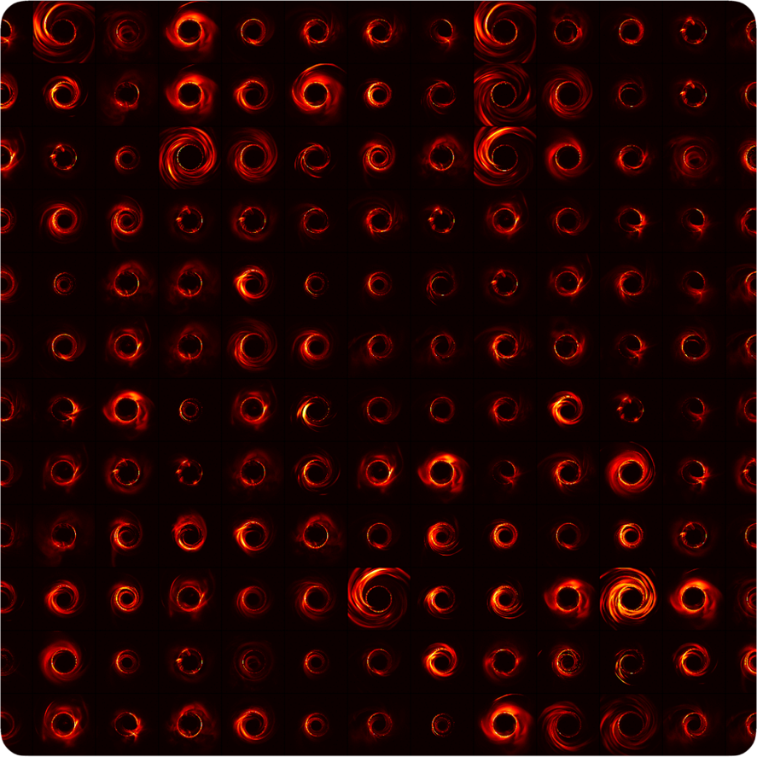

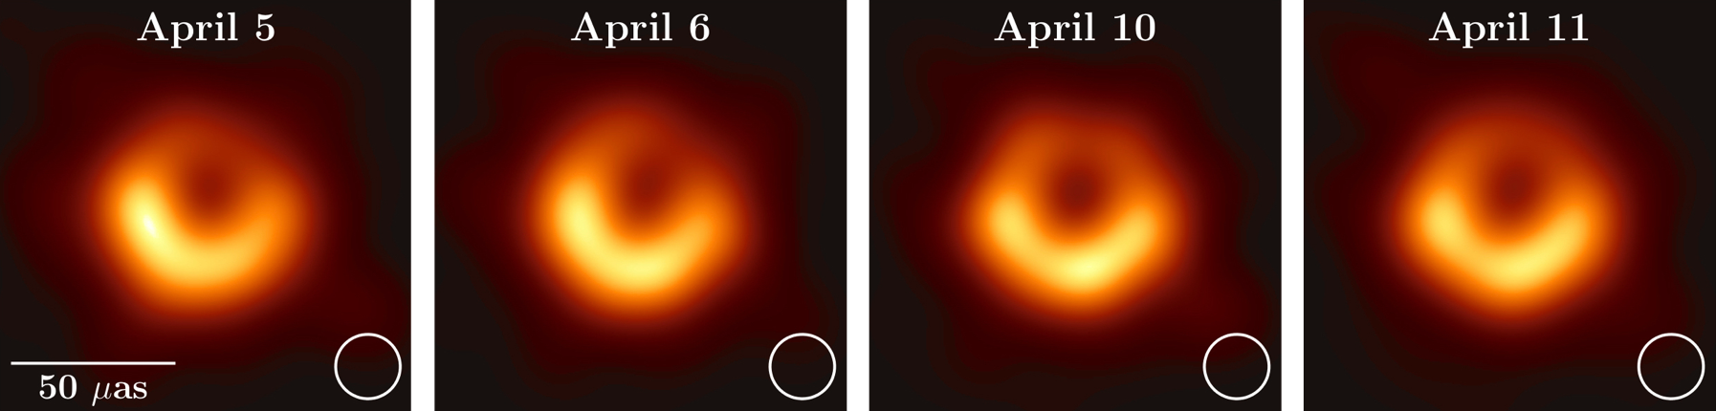

Event Horizon Telescope Bringing Black Holes into Focus
480,000 jobs - 2,600,000 core hours
#15 in all OSG projects in last 6 months
8 telescopes: 5 PB of data
60 simulations: 35 TB data
#2 in all OSG astronomy projects in the last 6 months
Pegasus-SYMBA Pipeline
Physically accurate synthetic observation data from simulations are keys to develop calibration and imaging algorithms, as well as comparing the observation with theory and interpreting the results.
Pull simulated image
from CyVerse Data Store
1
Push synthetic
observation data
back to CyVerse
6
2
Model interstellar scattering
3
Synthetic interferometry data
4
Model observation systematics
5
Calibrate synthetic observation
First images of black hole at the center of the M87 galaxy
Improve constraints on Einstein's theory of general relativity by 500x
Notes:
Numbers current as of Dec 2020. Bag of task workflow. Inputs are downloaded from the CyVerse datastore via WebDAV, and after processing results are uploaded back to the datastore.
Usually we have ~1000 jobs active jobs running in parallel on the OSG. This is also limited by I/O limitations from CyVerse. The total number of jobs in a single workflow is relatively arbitrary. At the moment we usually run with 50-100k. So far we had no problems scaling this with Pegasus.

Slide 10
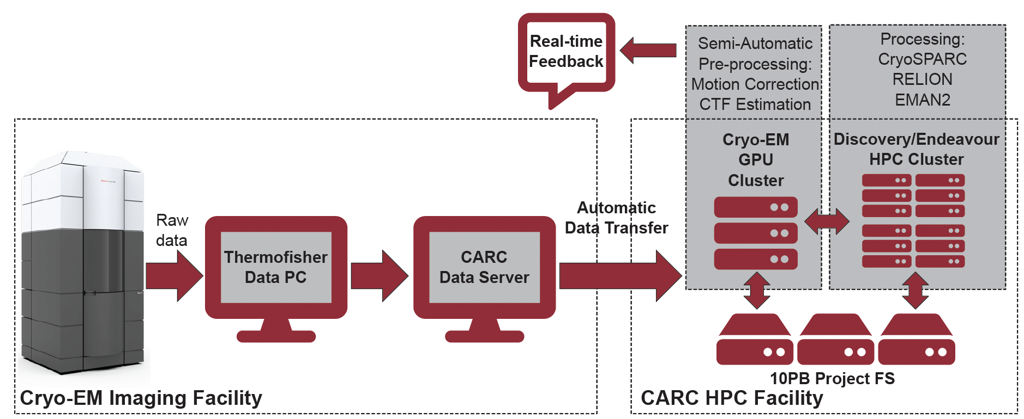
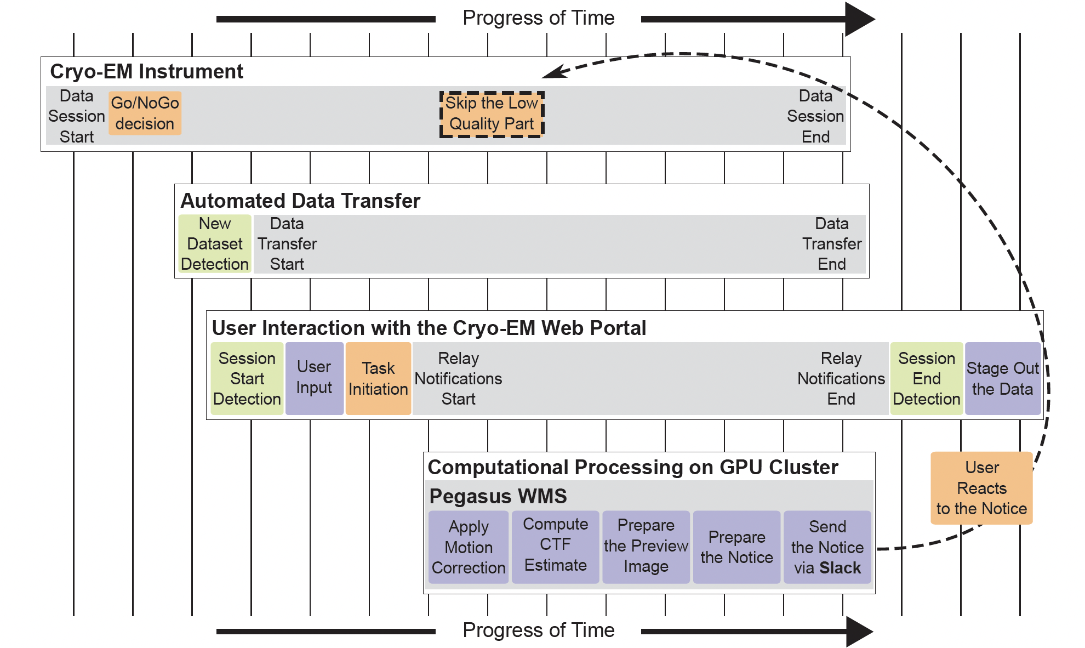
Processing instrument data in real time

Slide 11

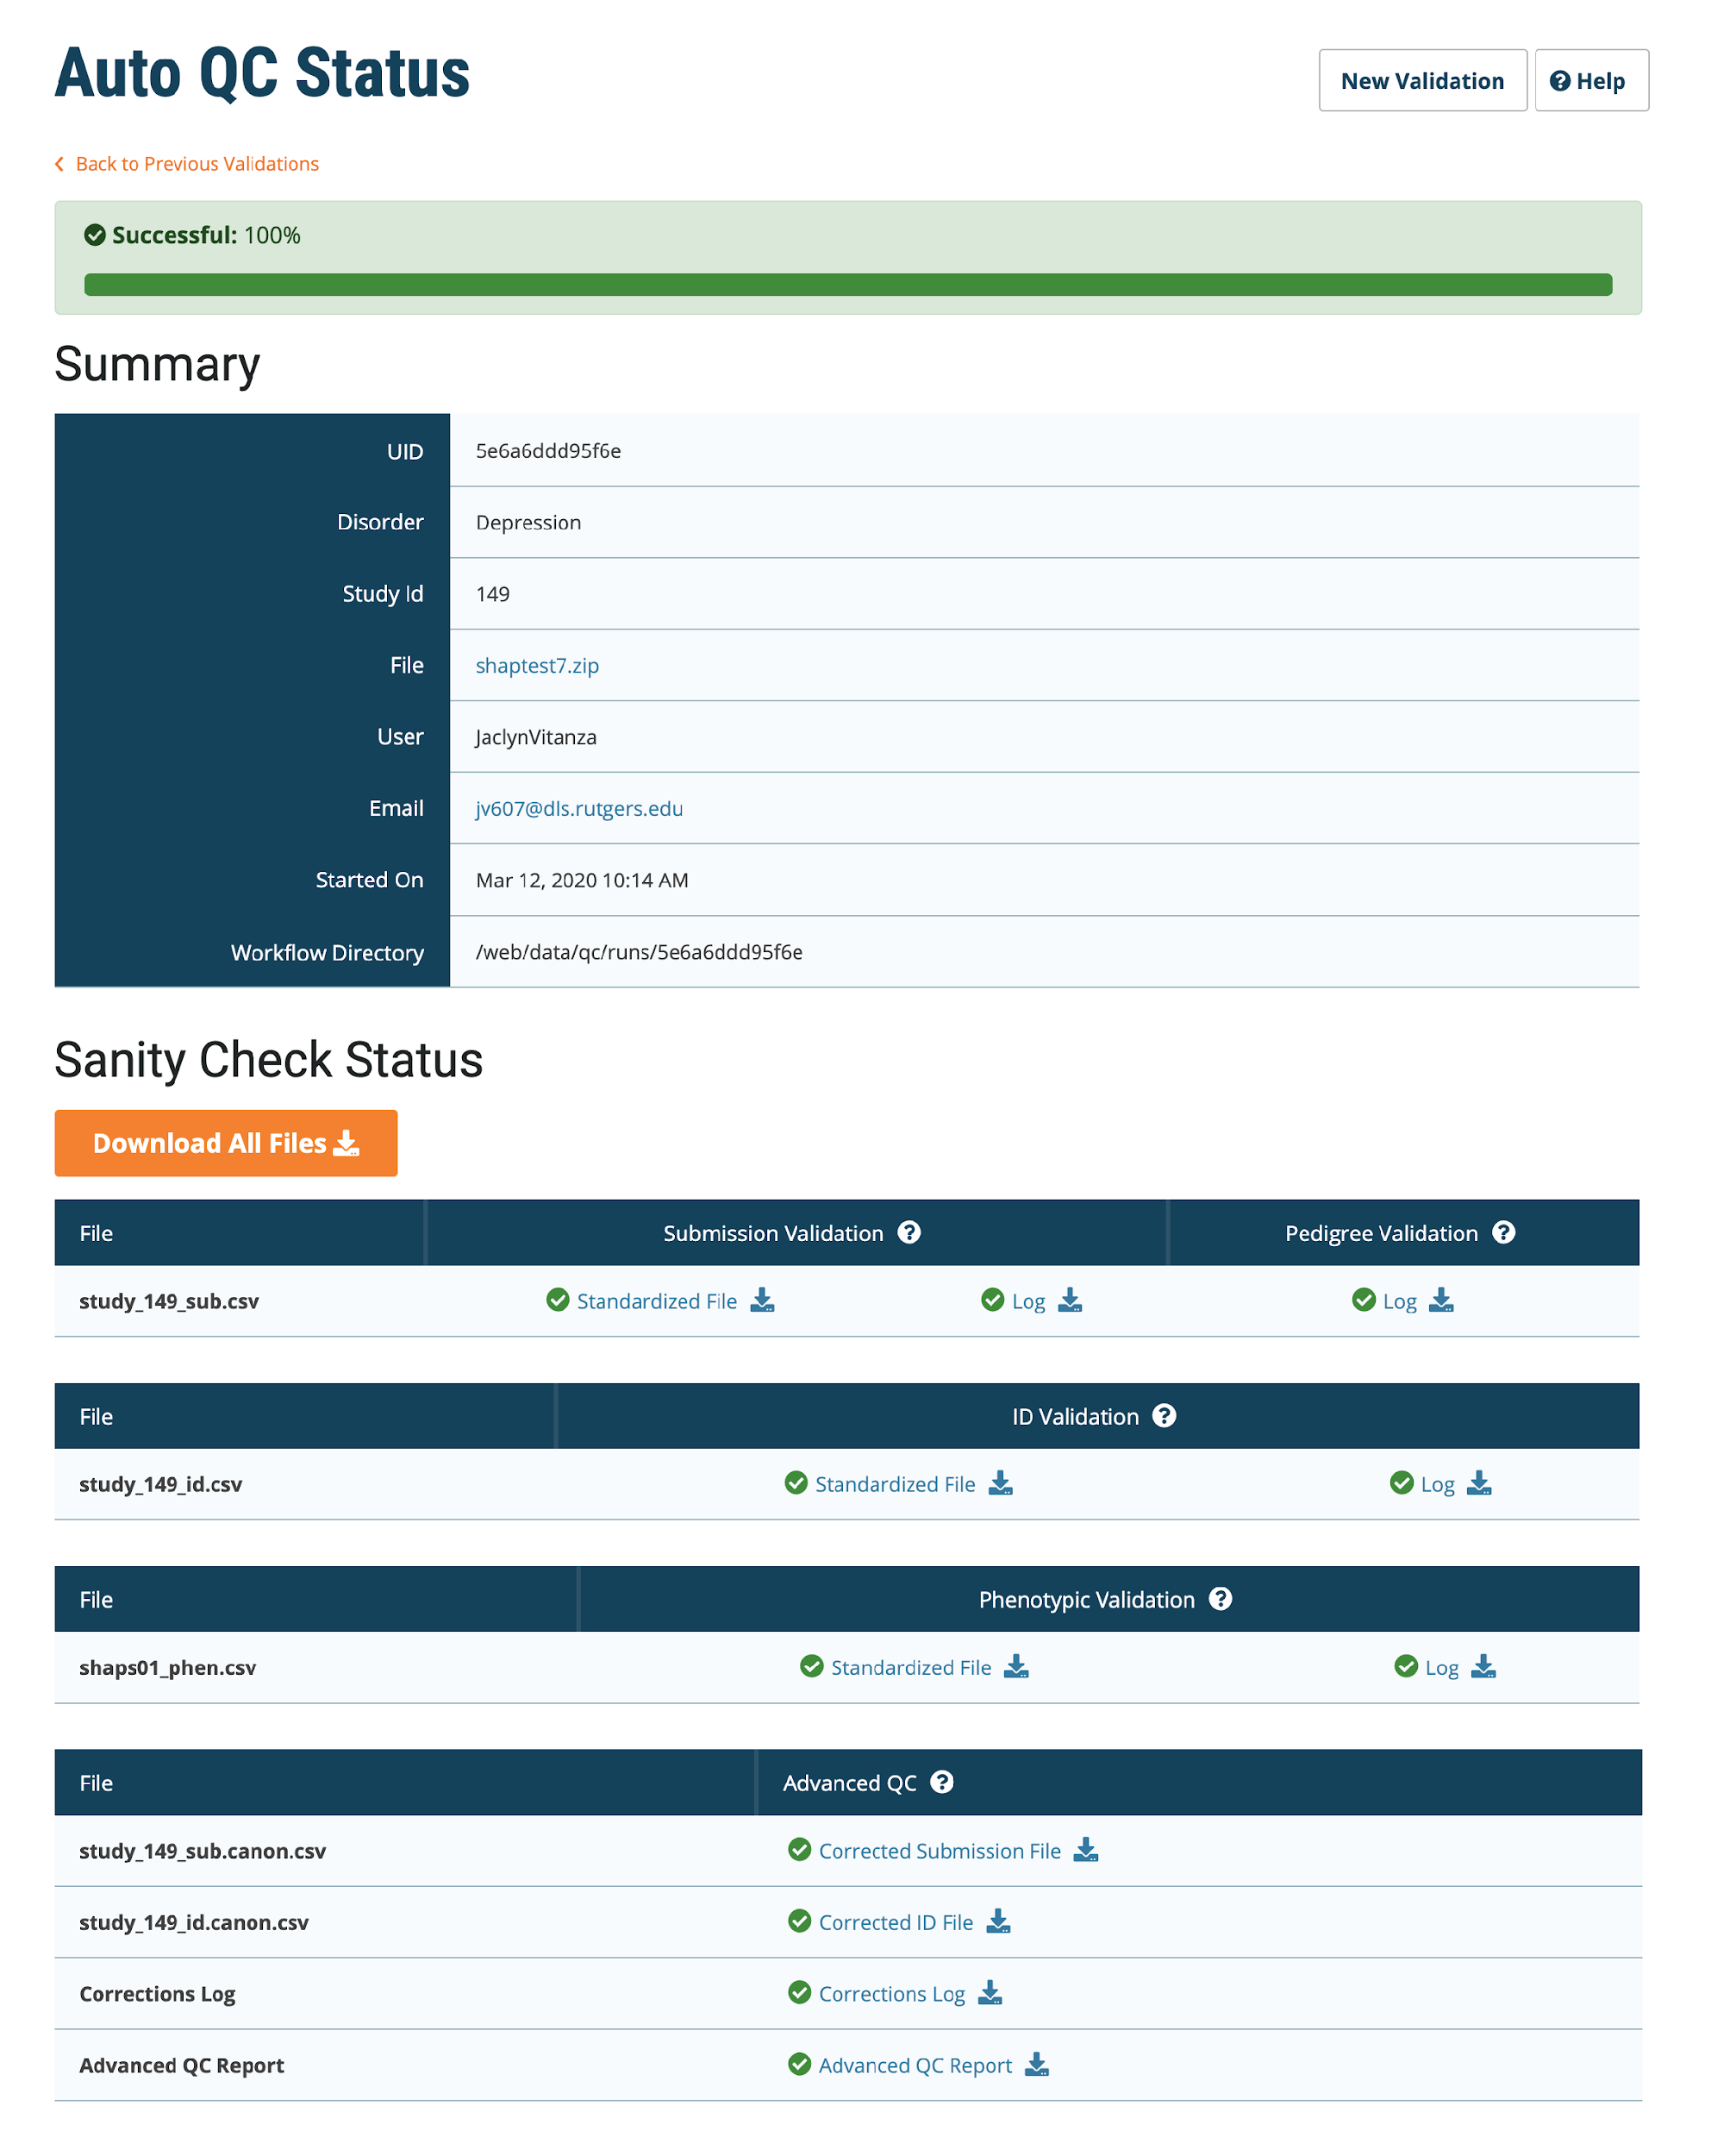
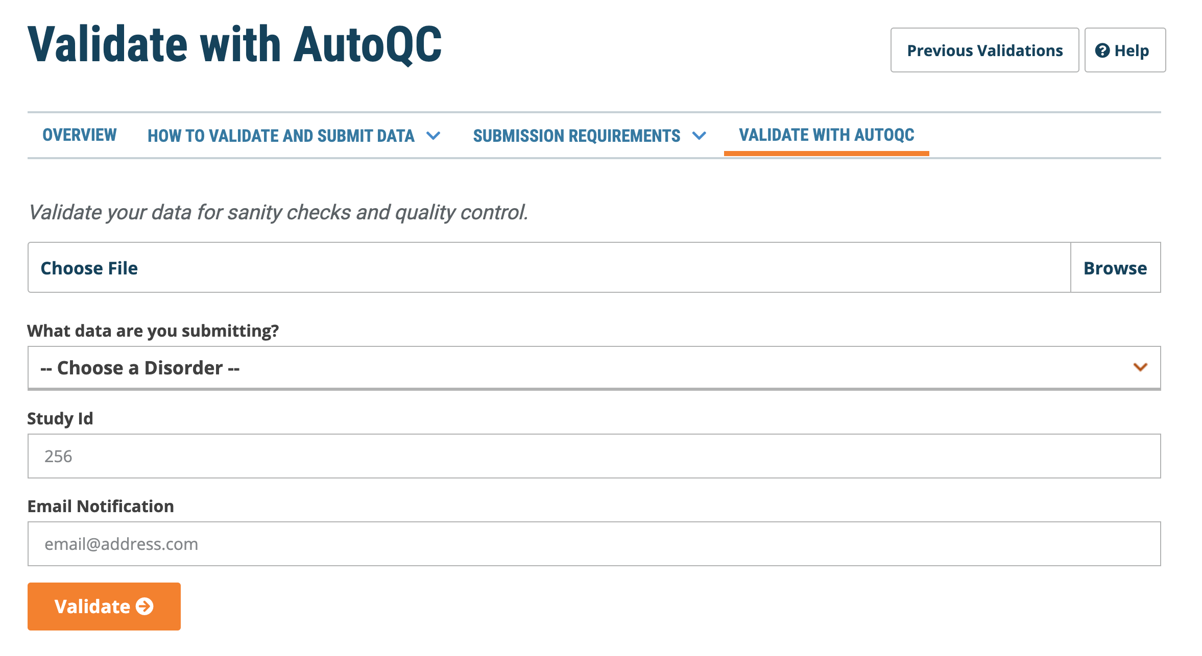
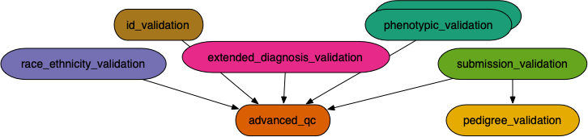
Automated Quality Control of Phenotypic Datasets
The NIMH Center for Collaborative Genomic Studies on Mental Disorders, now known as the NIMH Repository and Genomics Resource (NRGR), maintains biomaterials, demographic, and phenotypic data from over 200,000 well-characterized individuals with a range of psychiatric illnesses, their family members, and unaffected controls.
QC Report
Easy to Use Web-Based Interface
Simple Submission
Real-time Monitoring and Error Reports
After automated QC, submit corrected files for expert curation
Scalable
Workflow based architecture using Pegasus WMS
Extensible Design
Easily add new QC steps, and checks
Enables Complex checks
Pedigree Checks
QC Checks validating data with external sources
QC Checks can correlate data across multiple files and across multiple fields within files
Ensures high-quality uniform data deposited at NRGR
Better resource utilization: solve most QC problems automatically, use expert curation for hard cases
Submission
Website
Automated
QC Workflow
Load
NRGR
Warehouse
Export
Query
Manual
Curation
Download Data
Tool
Data
Explorer

Slide 12
Basic Concepts…

Slide 13
Key Pegasus Concepts
Pegasus WMS ==
Pegasus planner (mapper) + DAGMan workflow engine + HTCondor scheduler/broker
Pegasus maps workflows to infrastructure
DAGMan manages dependencies and reliability
HTCondor is used as a broker to interface with different schedulers
Workflows are DAGs
Nodes: jobs, edges: dependencies
No while loops, no conditional branches
Jobs are standalone executables
Planning occurs ahead of execution
Planning converts an abstract workflow into a concrete, executable workflow
Planner is like a compiler

Slide 14


Input Workflow Specification
directed-acyclic graphs
Output Workflow
YAML formatted
Portable Description
Users do not worry about low level execution details
Stage-in Job
Transfers the workflow input data
Logical Filename (LFN)
platform independent (abstraction)
ABSTRACT WORKFLOW
EXECUTABLE WORKFLOW
Cleanup Job
Transformation
Removes unused data
Executables (or programs) platform independent
Stage-out Job
Stage-out generated output data
Registration Job
Registers the workflow output data

Slide 15
So, what information does Pegasus need?
Site Catalog
Transformation Catalog
Describes the sites where
The workflow jobs are to be executed
Describes all of the executables
(called “transformations”)
used by the workflow
Replica Catalog
Describes all of the input data stored
on external servers

Slide 16
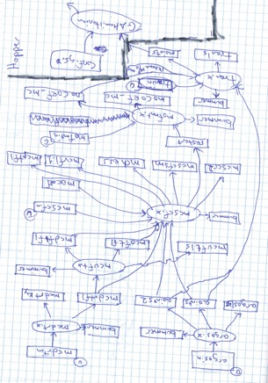
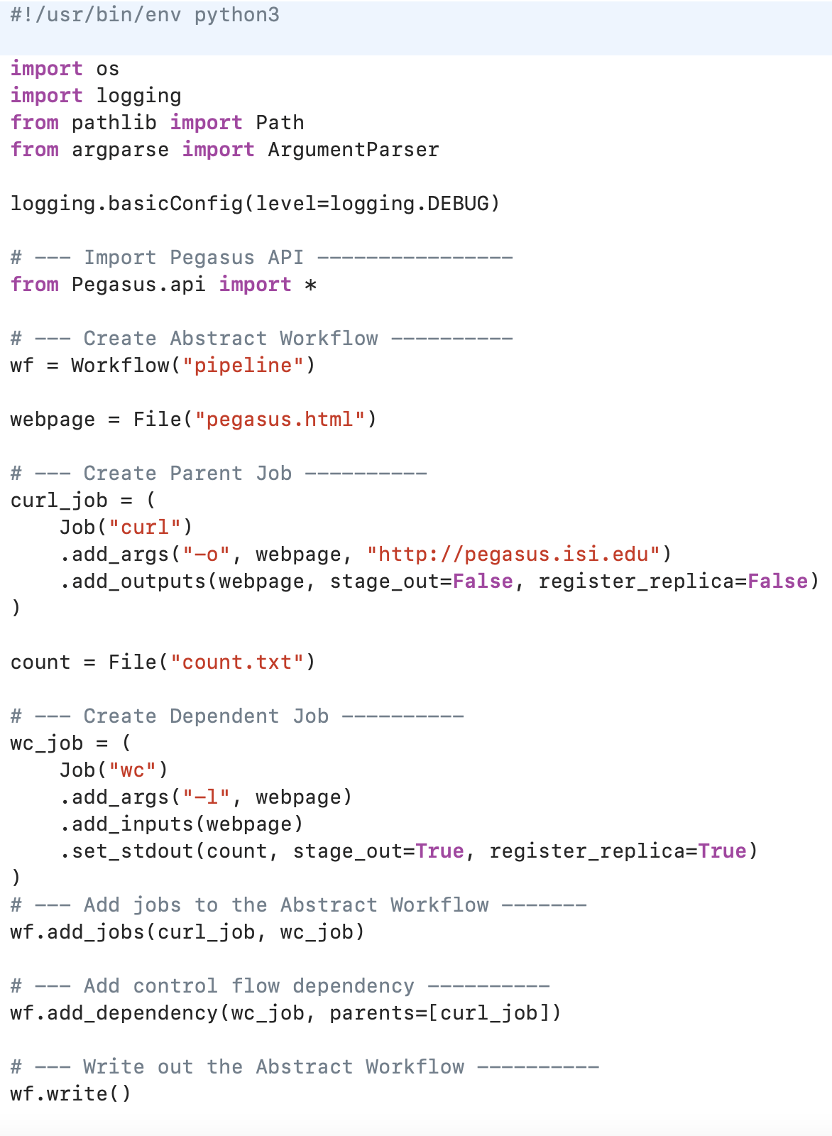
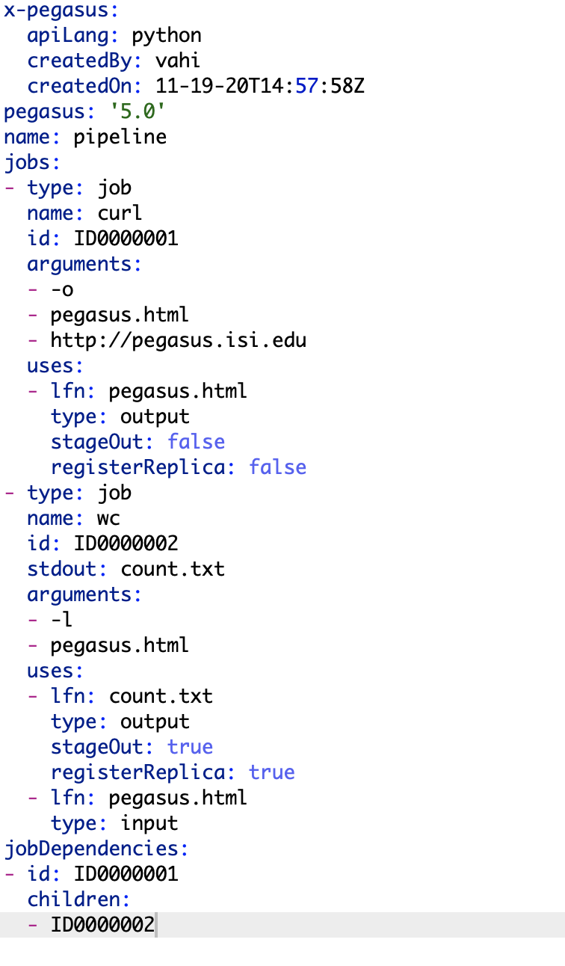

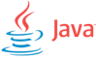


Pegasus also provides tools to generate the Abstract Workflow
YAML Formatted
Abstract
Workflow

Slide 17

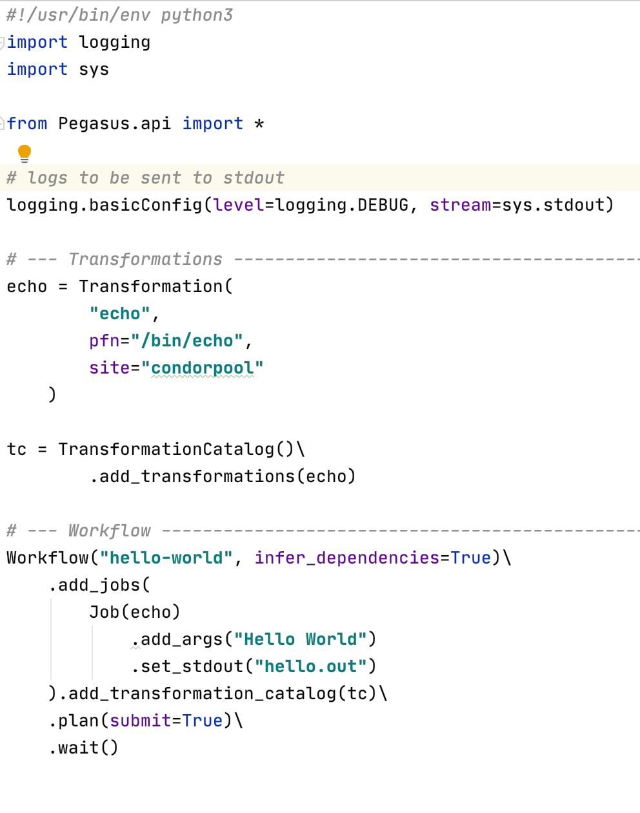
Pegasus 5.0
New and fresh Python3 API to compose, submit and monitor workflows, and configure catalogs
New Catalog Formats
Python 3 Support
All Pegasus tools are Python 3 compliant
Python PIP packages for workflow composition and monitoring
Zero configuration required to submit to local HTCondor pool.
Data Management Improvements
New output replica catalog that registers outputs including file metadata such as size and checksums
Improved support for hierarchical workflows
Reworked Documentation and Tutorial
https://pegasus.isi.edu/documentation/

Slide 18
Pegasus Deployment
SUBMIT HOST
Workflow Submit Node
Compute Site 1
Input Data Site
F.in
Pegasus Lite
Instance
Pegasus WMS
HTCondor
F.in
J1
T1
T1
One or more Compute Sites
F.int
Compute Clusters
Cloud
OSG
WN
WN
Staging Site
F.int
T2
Compute Site n
Pegasus Lite
Instance
F.out
Input Sites
J2
T2
Output Data Site
Host Input Data
F.out
Data Staging Site
WN
WN
Coordinate data movement for workflow
LEGEND
Output Site
Task flow +
Checksums
Directory
Setup Job
Data
Stageout Job
Check
Integrity Job
Pegasus Lite Compute Job
J
Where output data is placed
Data
Stagein Job
Directory
Cleanup Job
Checksum Generation Job
Worker Node
(WN)
Data Flow
WN

Slide 19
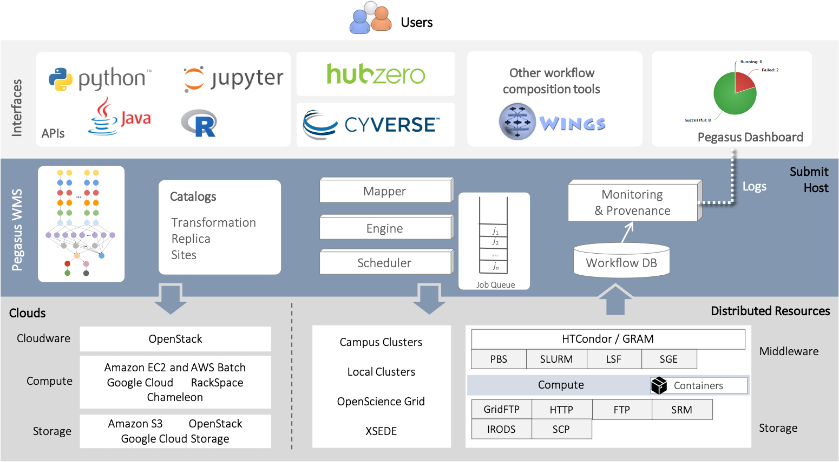

Science Gateways and Portals
Interfaces
System Architecture
Catalogs
Mapper
Monitoring
& Provenance
Transformations
Replica
Sites
Submit
Host
Pegasus WMS
Engine
j1
j2
...
Scheduler
jn
Job Queue
Workflow DB
Cloudware
OpenStack
Campus Clusters
Local Clusters
OpenScience Grid
ACCESS
HTCondor / GRAM
PBS
SLURM
LSF
SGE
Middleware
Clouds
Amazon EC2 & AWS Batch
Google Cloud | RackSpace
Chameleon
Distributed Resources
Compute
Compute
Containers
Amazon S3 | OpenStack
Google Cloud Storage
GridFTP
HTTP
FTP
SRM
Storage
Storage
IRODS
SCP

Slide 20
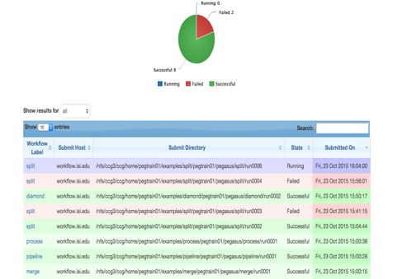
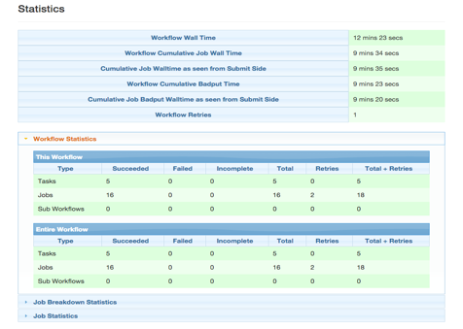
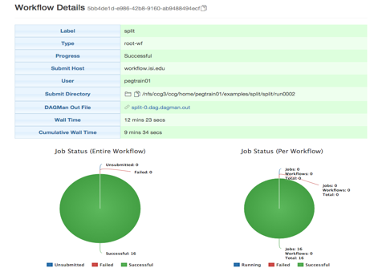
PEGASUS
DASHBOARD
web interface for monitoring
and debugging workflows
Real-time monitoring of workflow executions. It shows the status of the workflows and jobs, job characteristics, statistics and performance metrics.
Real-time Monitoring
Reporting
Debugging
Provenance data is stored into a relational database.
Troubleshooting
RESTful API

Slide 21
command-line…
$ pegasus-status pegasus/examples/split/run0001 STAT IN_STATE JOB
Run 00:39 split-0 (/home/pegasus/examples/split/run0001)
Idle 00:03 ┗━split_ID0000001
Summary: 2 Condor jobs total (I:1 R:1)
UNRDY READY PRE IN_Q POST DONE FAIL %DONE STATE DAGNAME
14 0 0 1 0 2 0 11.8 Running *split-0.dag
$ pegasus-analyzer pegasus/examples/split/run0001
pegasus-analyzer: initializing...
****************************Summary***************************
Total jobs : 7 (100.00%)
# jobs succeeded : 7 (100.00%)
# jobs failed : 0 (0.00%)
# jobs unsubmitted : 0 (0.00%)
$ pegasus-statistics –s all pegasus/examples/split/run0001
------------------------------------------------------------------------------
Type Succeeded Failed Incomplete Total Retries Total+Retries
Tasks 5 0 0 5 0 5
Jobs 17 0 0 17 0 17
Sub-Workflows 0 0 0 0 0 0
------------------------------------------------------------------------------
Workflow wall time : 2 mins, 6 secs
Workflow cumulative job wall time : 38 secs
Cumulative job wall time as seen from submit side : 42 secs
Workflow cumulative job badput wall time :
Cumulative job badput wall time as seen from submit side :
Provenance Data
can be Summarized
Pegasus-Statistics or
Used for Debugging
Pegasus-Analyzer

Slide 22

And if a job fails?
Postscript
Job Retry
detects non-zero exit code output parsing for success or failure message exceeded timeout do not produced expected output files
helps with transient failures set number of retries per job and run
Checkpoint Files
Rescue DAGs
job generates checkpoint files staging of checkpoint files is automatic on restarts
workflow can be restarted from checkpoint file recover from failures with minimal loss

Slide 23
ACCESS…

Slide 24
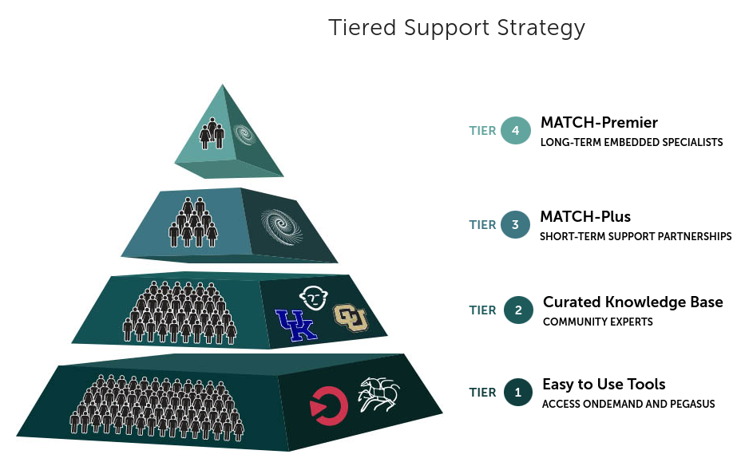
Pegasus is part of the ACCESS support strategy
Pegasus will be used as a tier 1 tool
Central Open OnDemand instance with Pegasus, HTCondor and Jupyter
It will be easy to run HTC workflows across ACCESS sites

Slide 25
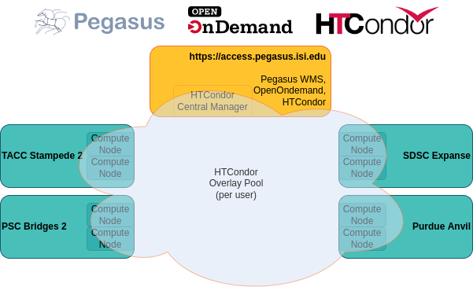

Slide 26
HTCondor Annex / Pilot Jobs
A pilot can run multiple user jobs - it stays active until no more user jobs are available or until end of life has been reached, whichever comes first.
A pilot is partitionable - job slots will dynamically be created based on the resource requirements in the user jobs. This means you can fit multiple user jobs on a compute node at the same time.
A pilot will only run jobs for the user who started it.

Slide 27
Understanding Pegasus Features…

Slide 28
Pegasus-transfer
Pegasus’ internal data transfer tool with support for a number of different protocols
HTTP
SCP
GridFTP
Globus Online
iRods
Amazon S3
Google Storage
SRM
FDT
Stashcp
Rucio
cp
ln -s
Directory creation, file removal
If protocol can support it, also used for cleanup
Two stage transfers
e.g., GridFTP to S3 = GridFTP to local file, local file to S3
Parallel transfers
Automatic retries
Credential management
Uses the appropriate credential for each site and each protocol (even 3rd party transfers)

Slide 29
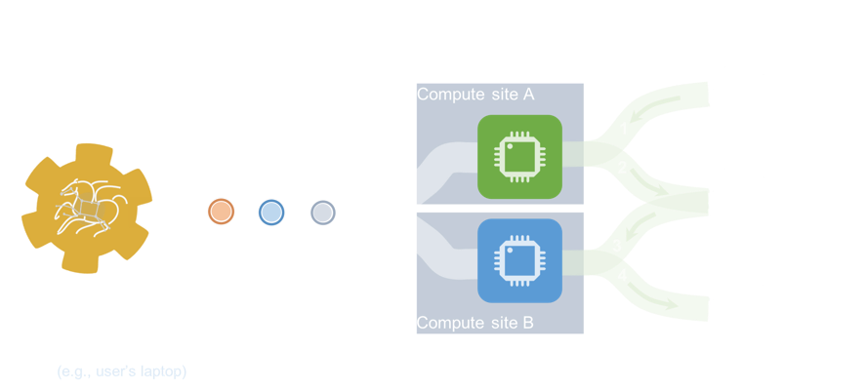
Data Staging Configurations
HTCondor I/O (HTCondor pools, OSG, …)
Worker nodes do not share a file system
Data is pulled from / pushed to the submit host via HTCondor file transfers
Staging site is the submit host
Non-shared File System (clouds, OSG, …)
Worker nodes do not share a file system
Data is pulled / pushed from a staging site, possibly not co-located with the computation
Shared File System
(HPC sites, XSEDE, Campus clusters, …)
I/O is directly against the shared file system

Slide 30



High Performance Computing
There are several possible configurations…
Compute Site
Shared Filesystem
Input data site
Data staging site
Output data site
Submit Host
Typically Most HPC Sites

Slide 31
Cloud Computing
High-scalable object storages
Compute Site
Object Storage
Input data site
Data staging site
Output data site
Staging Site
Submit Host
Typical cloud computing deployment
(Amazon S3, Google Storage)

Slide 32
Grid Computing
Local data management
Compute Site
Typical OSG sites
Open Science Grid
Submit Host

Slide 33

Running fine-grained workflows on HPC systems…
Compute Site
Submit Host
(e.g., user’s laptop)
Workflow wrapped as an MPI job
Allows sub-graphs of a Pegasus workflow to be submitted as monolithic jobs to remote resources

Slide 34



Pegasus Container Support
Containers Execution Model
Users can refer to containers in the Transformation Catalog with their executable preinstalled
Directory Setup
Host OS
Pull image
Users can refer to a container they want to use – Pegasus stages their executables and containers to the node
Start container
$PWD bind-mounted as/srv
Container
Instance
Useful if you want to use a site recommended/standard container image.
Users are using generic image with executable staging.
Pull worker package
(if needed)
Set job environment
Future Plans
Stage in inputs
Execute user application
Users can specify an image buildfile for their jobs.
Pegasus will build the Docker image as separate jobs in the executable workflow, export them as a tar file and ship them around
Stage out outputs
Stop container
Cleanup

Slide 35
Data Management for Containers
Containers are data too!
Pegasus treats containers as input data dependency
Staged to compute node if not present
Docker or Singularity Hub URL’s
Docker Image exported as a TAR file and available at a server, just like any other input dataset
Scaling up for larger workflows
The image is pulled down as a tar file as part of data stage-in jobs in the workflow
The exported tar file is then shipped with the workflow and made available to the jobs
Pricing considerations. You are now charged if you exceed a certain rate of pulls from Hubs
Other Optimizations
Symlink against existing images on shared file system such as CVMFS
The exported tar file is then shipped with the workflow and made available to the jobs

Slide 36
Clustered Job
Groups small jobs together
to improve performance
Task
Small granularity
Performance.
Why not improve it?

Slide 37


Pegasus also handles large-scale workflows
Sub-Workflow
Sub-Workflow
Recursion ends
When abstract workflow with only compute jobs is encountered

Slide 38





Data Reuse prune jobs if output data already exists
data reuse
data already available
workflow reduction
data reuse
Jobs which output data is
already available are pruned from the DAG
data also available

Slide 39
And if a job fails?
Postscript
Job Retry
detects non-zero exit code output parsing for success or failure message exceeded timeout do not produced expected output files
helps with transient failures set number of retries per job and run
Checkpoint Files
Rescue DAGs
job generates checkpoint files staging of checkpoint files is automatic on restarts
workflow can be restarted from checkpoint file recover from failures with minimal loss

Slide 40
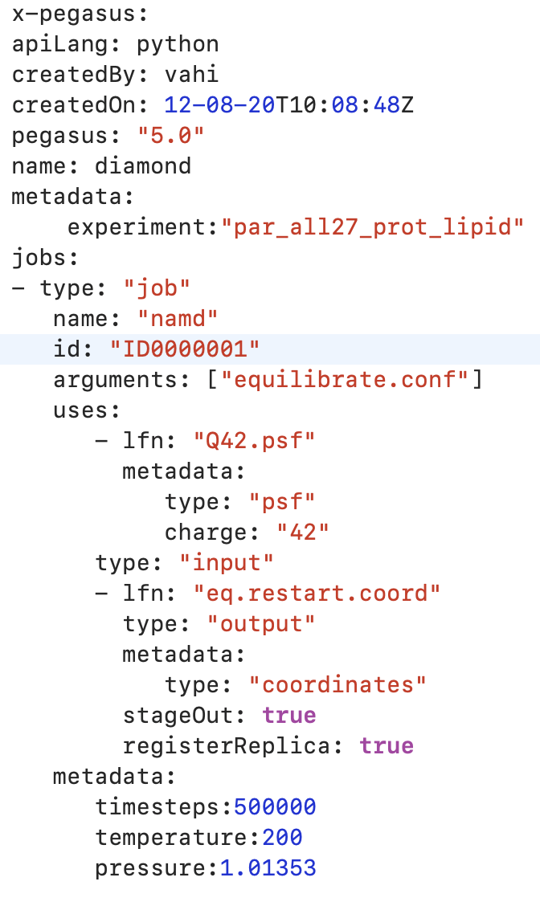

Metadata
Can associate arbitrary key-value pairs with workflows, jobs, and files
Data Registration
Static and Runtime Metadata
Static metadata from
DAX and catalogs
Runtime Metadata
Output files get tagged with metadata on registration in the workflow database
Static: application parameters
Runtime: performance metrics
Netlogger
Events
Collected from
Kickstart records
Workflow Database
Workflow,
Job, File
Python Metadata API
Select Data Based on Metadata
S3
IRODS
Pegasus dashboards
Pegasus- metadata
(command line tool)
Register Data With Metadata
USER

Slide 41
Challenges to Scientific Data Integrity
Modern IT systems
are not perfect
- errors creep in.
Plus there is the threat of intentional changes: malicious attackers, insider threats, etc.
At modern “Big Data” sizes we are starting to see checksums breaking down.
User Perception: “Am I not already protected? I have heard about TCP checksums,
encrypted transfers, checksum validation, RAID and erasure coding – is that not enough?”

Slide 42
Automatic Integrity Checking in Pegasus
SUBMIT HOST
Compute Site 1
Input Data Site
F.in
Pegasus Lite
Instance
Pegasus performs integrity checksums on input files right before a job starts on the remote node.
F.in
J1
T1
T1
F.int
Staging Site
WN
WN
For raw inputs, checksums specified in the input replica catalog along with file locations
All intermediate and output files checksums are generated and tracked within the system.
Support for sha256 checksums
F.int
T2
Compute Site n
Pegasus Lite
Instance
F.out
J2
T2
Output Data Site
F.out
WN
WN
LEGEND
Job failure is triggered
if checksums fail
Task flow +
Checksums
Directory
Setup Job
Data
Stageout Job
Check
Integrity Job
J
Pegasus Lite Compute Job
Data Flow
Data
Stagein Job
Directory
Cleanup Job
Checksum Generation Job
Worker Node
(WN)
WN
Notes:
Currently, we have implemented and are enforcing integrity checking in the PegasusLite deployments, where a job on the remote compute node is launched by a llightweight Pegasus instance that is responsible for fetching the input data for the job and staging the output to the scratch space. Before a job starts, an integrity check step is performed to ensure that any input files staged to the compute node matches the checksum in the data catalogs. Any new files ( intermediate , and final output files) that are generated on the remote node have their checksums computed on the remote node itself. This information is brought back to Pegasus submit host as part of job’s stdout and then stored in our monitoring database.

Slide 43
REMOTE
Job Submissions
LOCAL
Submit Machine
BOSCO + SSH**
Personal HTCondor
Each node in executable workflow submitted via SSH connection to remote cluster
Local Campus Cluster accessible via Submit Machine **
BOSCO based Glideins**
SSH based submission of glideins
HTCondor via BLAHP
PyGlidein
IceCube glidein service
** Both Glite and BOSCO build on HTCondor BLAHP
Currenty supported schedulers:
SLURM SGE PBS MOAB
OSG using glideinWMS
Infrastructure provisioned glideins
CREAMCE
Uses CondorG
Globus GRAM
Uses CondorG

Slide 44
Credentials Management
Credentials required for two purposes
Job Submission
Data transfers to stage-in input and stage-out generated outputs when a job executes
Specifying Credentials
Users can specify credentials in a generic credentials file on submit host
Associate credentials with sites in site catalog
Approach
Planner will automatically associate the required credentials with each job
The credentials are transferred along with the job
Usually available only for the duration of the job execution
Supported Credentials
X.509 grid proxies
Amazon AWS S3 keys,
Google Cloud Platform OAuth token (.boto file),
iRods password
SSH keys
Web Dav

Slide 45

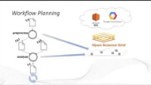
Get Started
Pegasus
est. 2001
Automate, recover, and debug scientific computations.
https://www.youtube.com/channel/UCwJQln1CqBvTJqiNr9X9F1Q/featured
YouTube Channel
Pegasus Website
https://pegasus.isi.edu
Users Mailing List
pegasus-users@isi.edu
Support
pegasus-support@isi.edu
Slack
Ask for an invite by trying to join pegasus-users.slack.com in the Slack app
Pegasus in 5 Minutes
Pegasus Online Office Hours
https://pegasus.isi.edu/blog/online-pegasus-office-hours/
Bi-monthly basis on second Friday of the month, where we address user questions and also apprise the community of new developments

